Slide 1


Privileged and Confidential

Slide 2
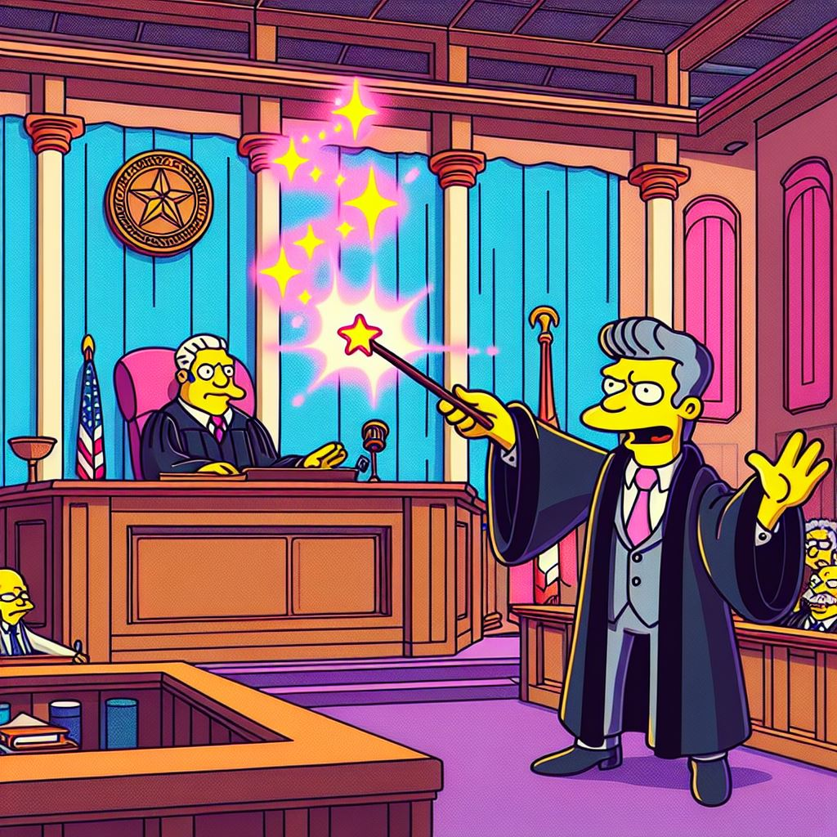
How many of these sound familiar?
Privilege is ‘invoked’ like a spell.
The legal team is tacked on to comms.
Privilege is avoided like the plague.
Legal advice is circulated broadly.
Settlement discussions kick off without formality.
Legal advice includes other advice.
AI is used to generate legal advice.

Slide 3

Test
Multiple choice
Self-report to the Law Society

Slide 4
Test
Question 1:
A project administrator sends parts of your emailed legal advice on to a counterparty, seeking to convince the counterparty that their position is wrong.
Has privilege in your advice been waived?
No way.
Yes, waive goodbye to it now.
It depends (waived and confused).

Slide 5
Test
Question 2:
Would the answer change if it was the whole advice and sent by the CEO?
Waived.
Not waived.

Slide 6
Test
Question 3:
A document is prepared to enable legal advice to be given. The document is never sent. Is the document privileged?
Probably
Probably not

Slide 7
Test
Question 4:
Is there a difference between “without prejudice” and “without prejudice to my position”?
Yes.
No.

Slide 8
Test
Question 5:
Is advice given to a NZ business from an overseas “manager, legal services” within the New Zealand business’s group privileged?
Probably
Probably not

Slide 9
Test
Bonus question:
How many IP laws have we breached in this presentation?
A few.
All of them.

Slide 10

Three Main Flavours
Legal Advice
Litigation
Settlement discussions

Slide 11

In-house Application
Full and frank discussion.
Incidents, advice, disputes.
Doesn’t cover other advice.
Overseas lawyers.
AI.

Slide 12

How to lose it
Waiver (express and implied).
Joint privilege.
Power to allow use of without prejudice documents.
Power to disallow.

Slide 13

Interesting examples
Successive drafts of documents.
Summaries of legal advice by non-lawyers.
Fee notes.

Slide 14
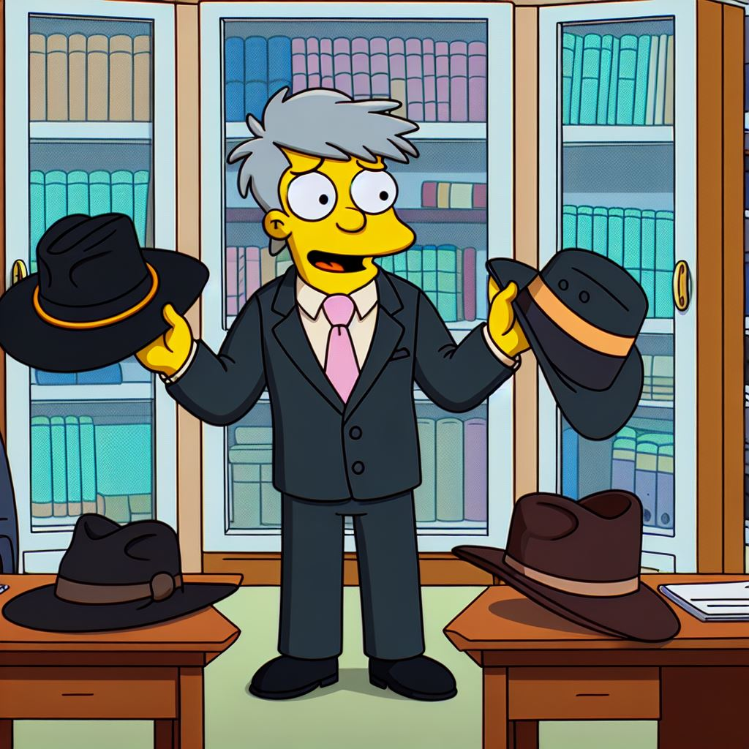
Tips
Maree Kondo your privilege.
Identify your hat.
Use your words.
Plan ahead.
Train stakeholders.

Slide 15
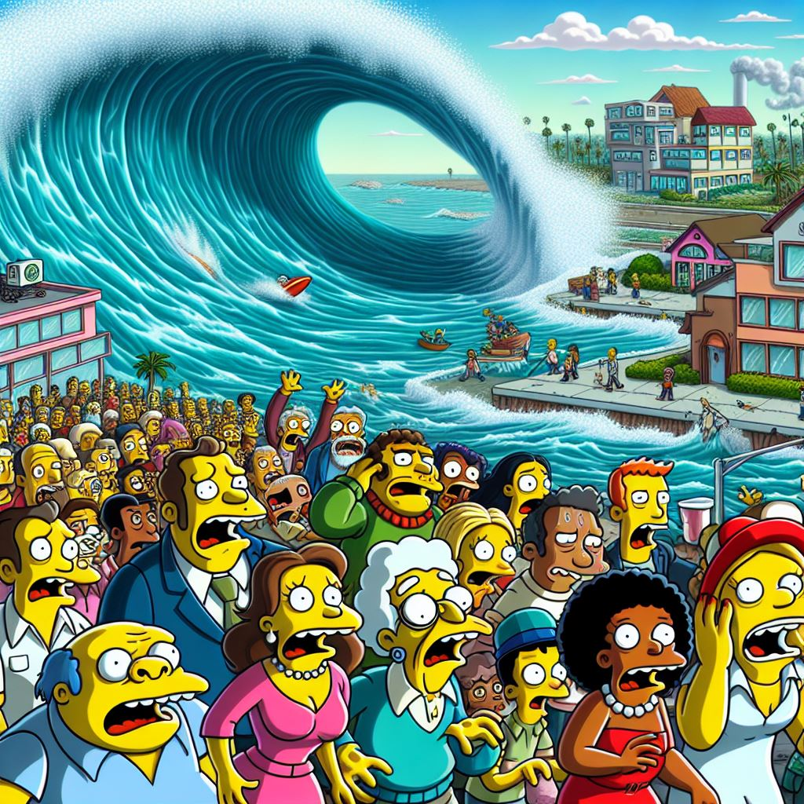
What to do in a disaster
We’ve all had those moments.
Panic slowly, act quickly.
Be clear on what you want the recipient to do.

Slide 16

Reform?
Law Commission Paper
  Documents not communicated
  Third parties.
Third Party
Document
Lawyer
Client
Advice

Slide 17
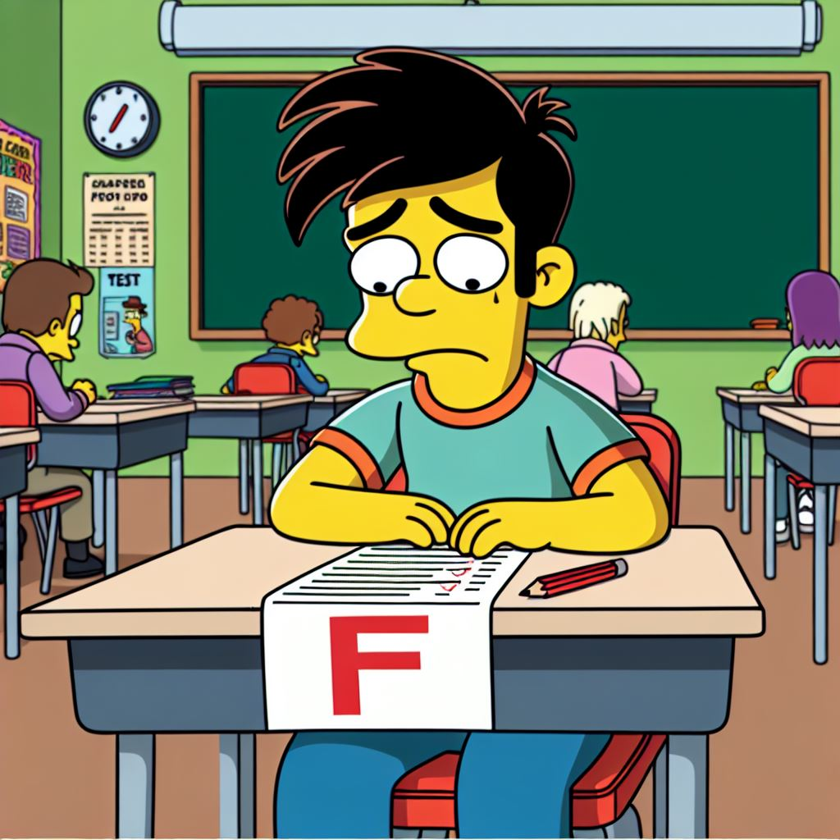
Test answers
Disbarred!

Slide 18
Test answers
Question 1:
A project administrator sends parts of your emailed legal advice on to a counterparty, seeking to convince the counterparty that their position is wrong.
Has privilege in your advice been waived?
No way.
Yes, waive goodbye to it now.
It depends (waived and confused).

Slide 19
Test answers
Question 2:
Would the answer change if it was the whole advice and sent by the CEO?
Waived.
Not waived.

Slide 20
Test answers
Question 3:
A document is prepared to enable legal advice to be given. The document is never sent. Is the document privileged?
Probably
Probably not

Slide 21
Test answers
Question 4:
Is there a difference between “without prejudice” and “without prejudice to my position”?
Yes.
No.

Slide 22
Test answers
Question 5:
Is advice given to a NZ business from an overseas “manager, legal services” within the New Zealand business’s group privileged?
Probably
Probably not

Slide 23
Test answers
Bonus question:
How many IP laws have we breached in this presentation?
That’s privileged!

Slide 24

Questions

