Slide 1
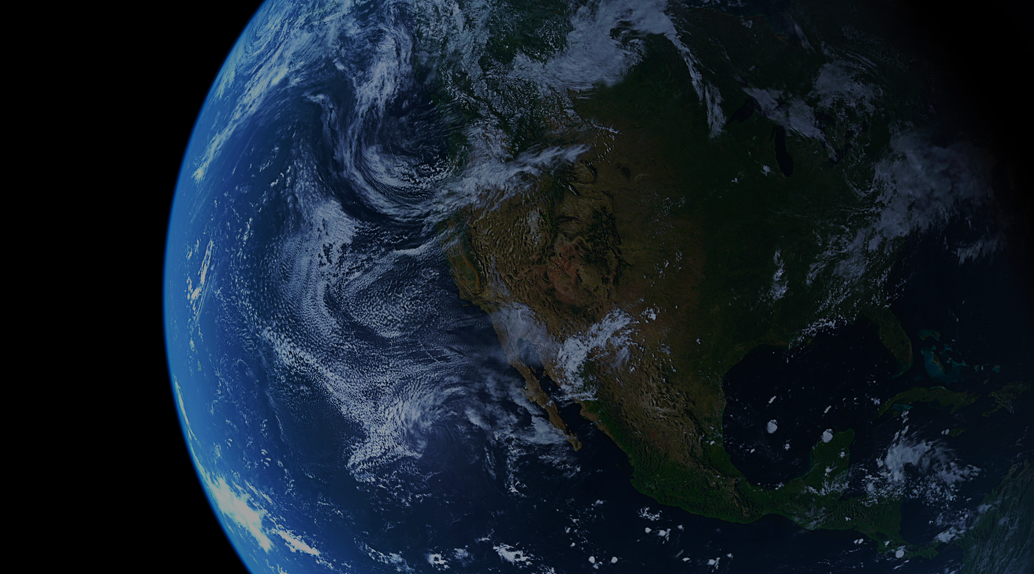
Can lawyers save the world?
Part B: Legal frameworks for climate issues, and lawyers’ ethical obligations on climate
Presenters: Sophie Meares, Susannah Sharpe and Debra Dorrington

Slide 2
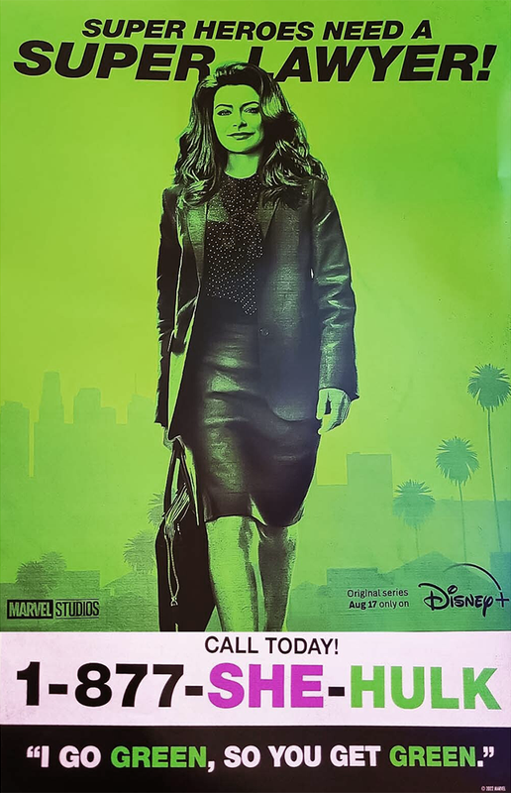
Discussion points
Climate legal frameworks
A climate-conscious career
Our ethical obligations
Panel discussion

Slide 3
1. Climate legal frameworks
NDC
International climate agreements
Trade
International context
System settings /
cross-cutting measures
Sector context
CCRA
Emissions pricing
Investment
Innovation
Regional measures
Tikanga
Agriculture
Built environment
Natural environment
Transport
Industrial and
process heat
Energy
Waste
Forestry

Slide 4
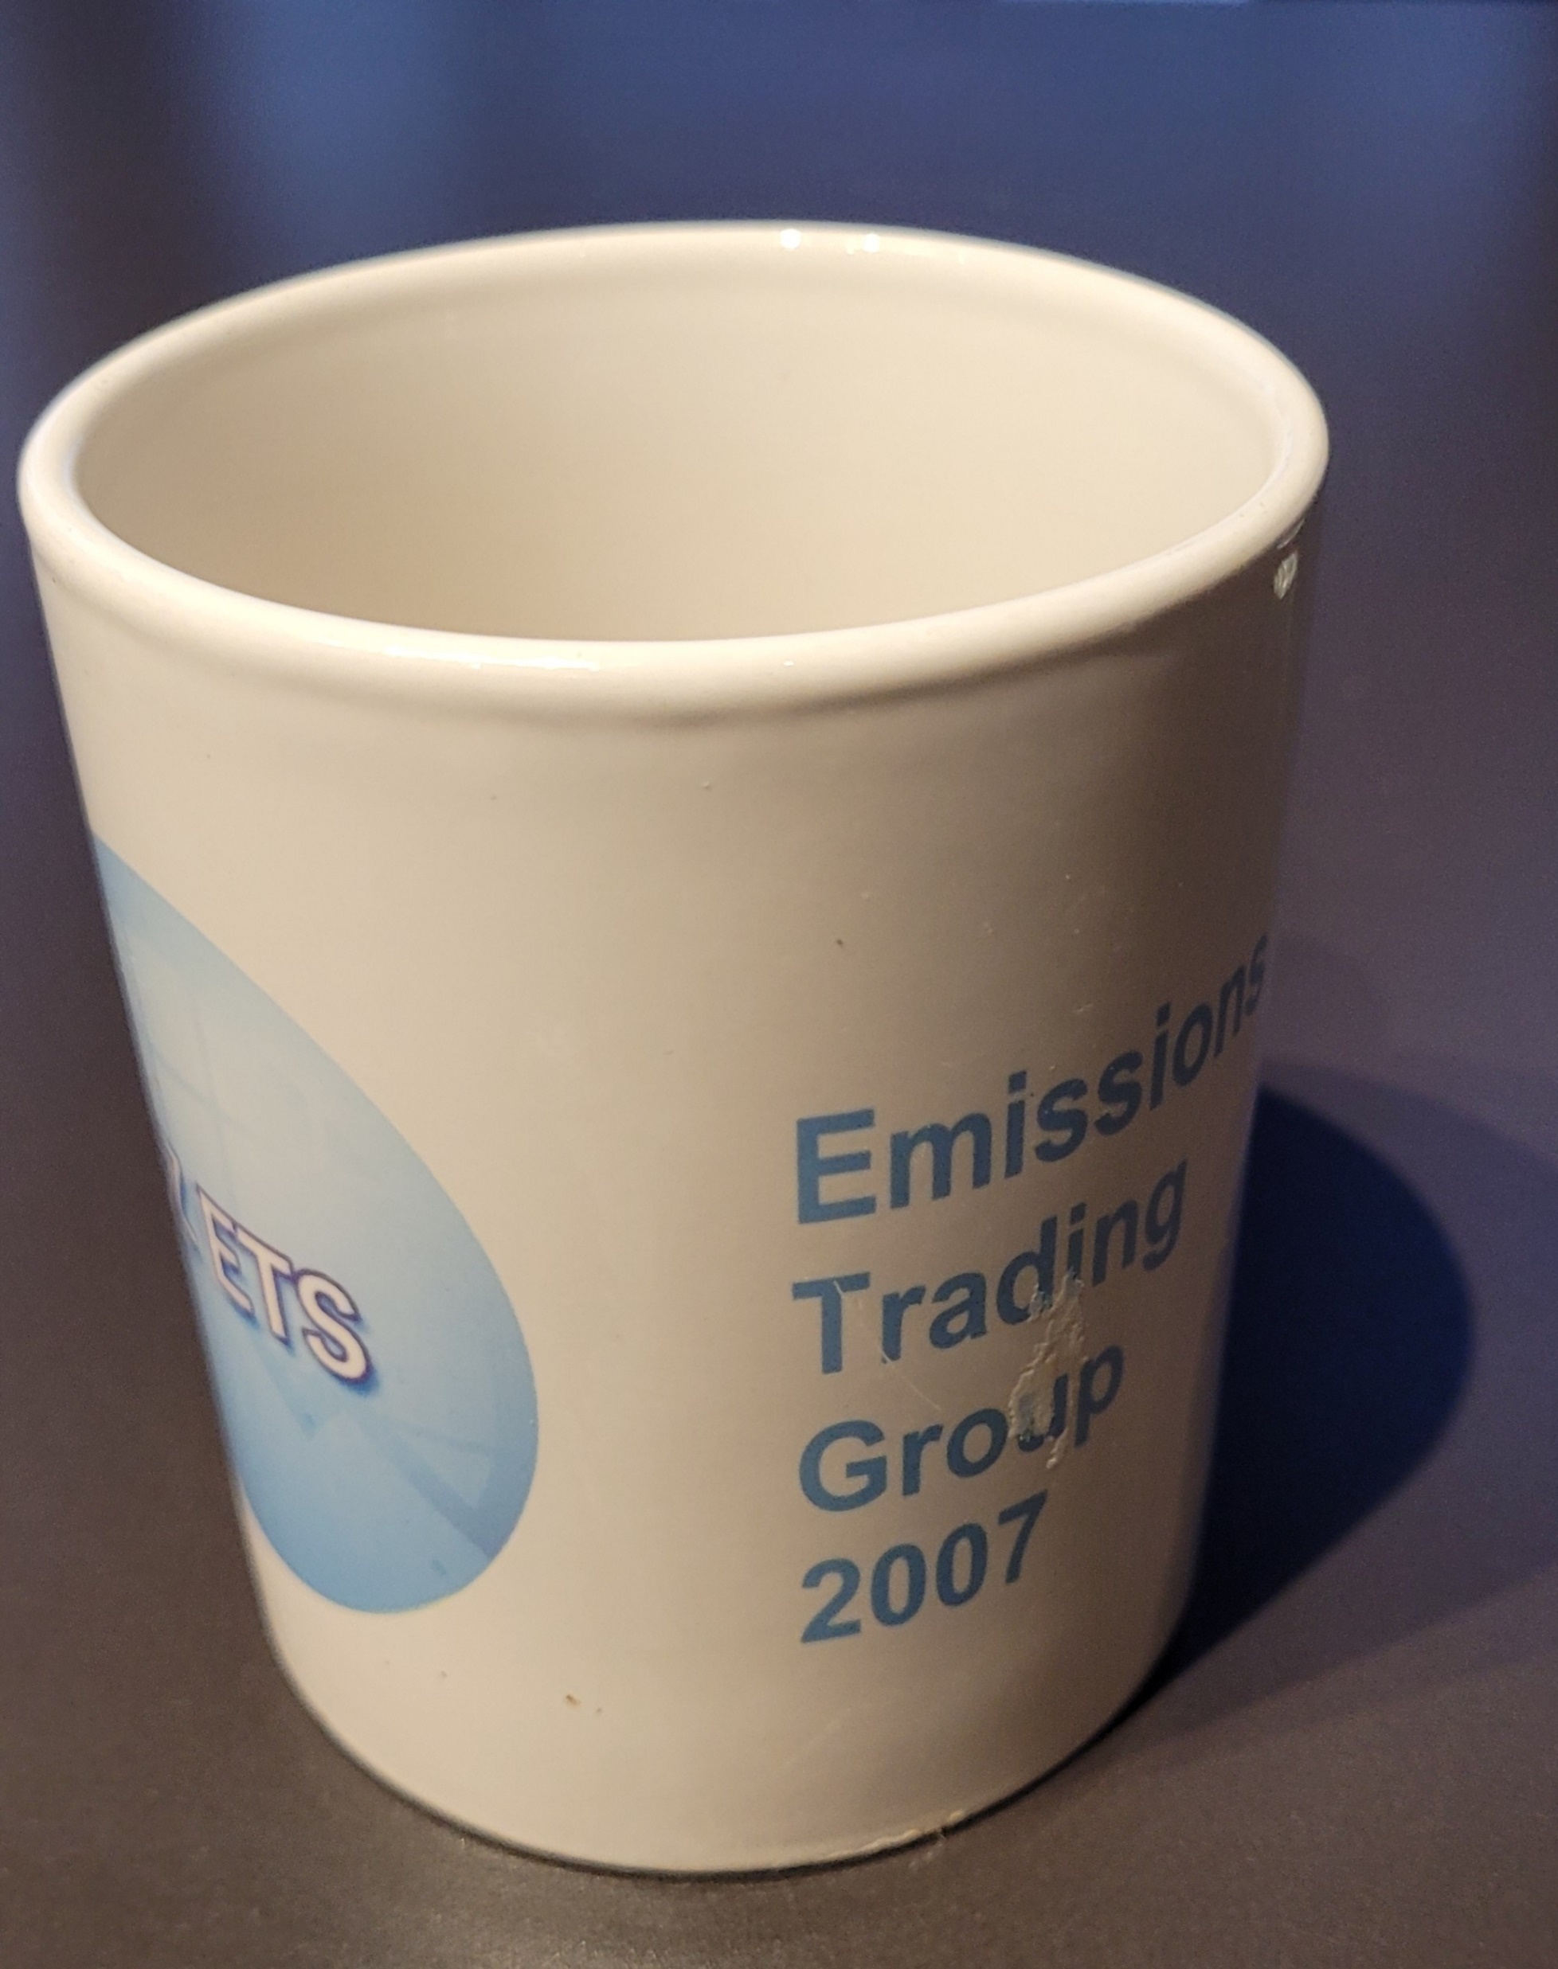
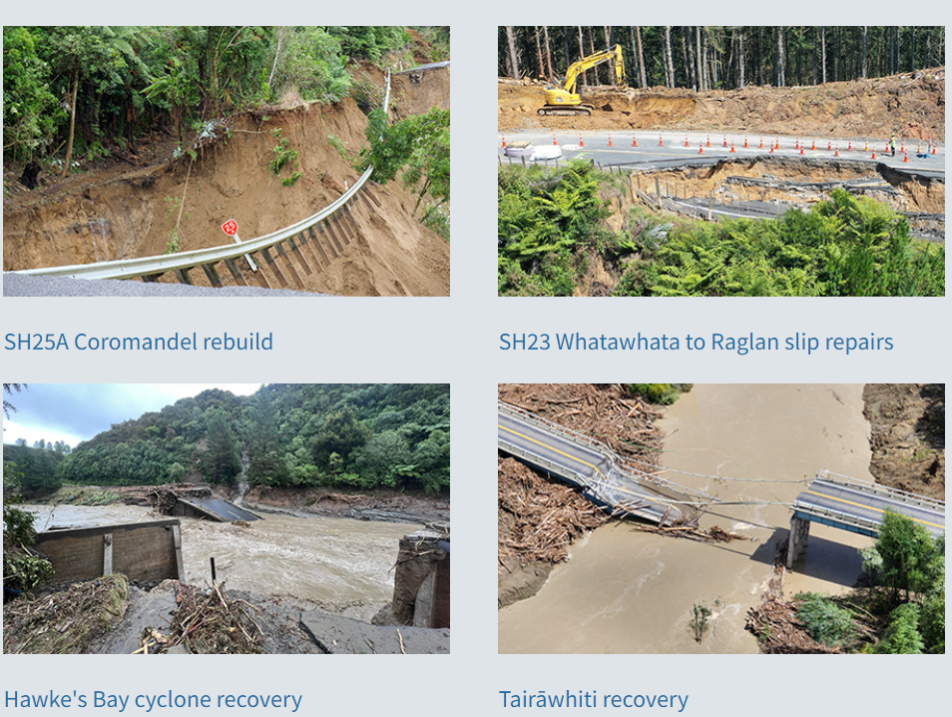
2. A climate-conscious career

Slide 5

3. Ethical obligations

Slide 6
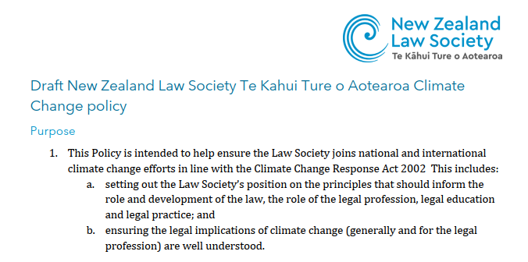
Draft Climate Change policy

Slide 7
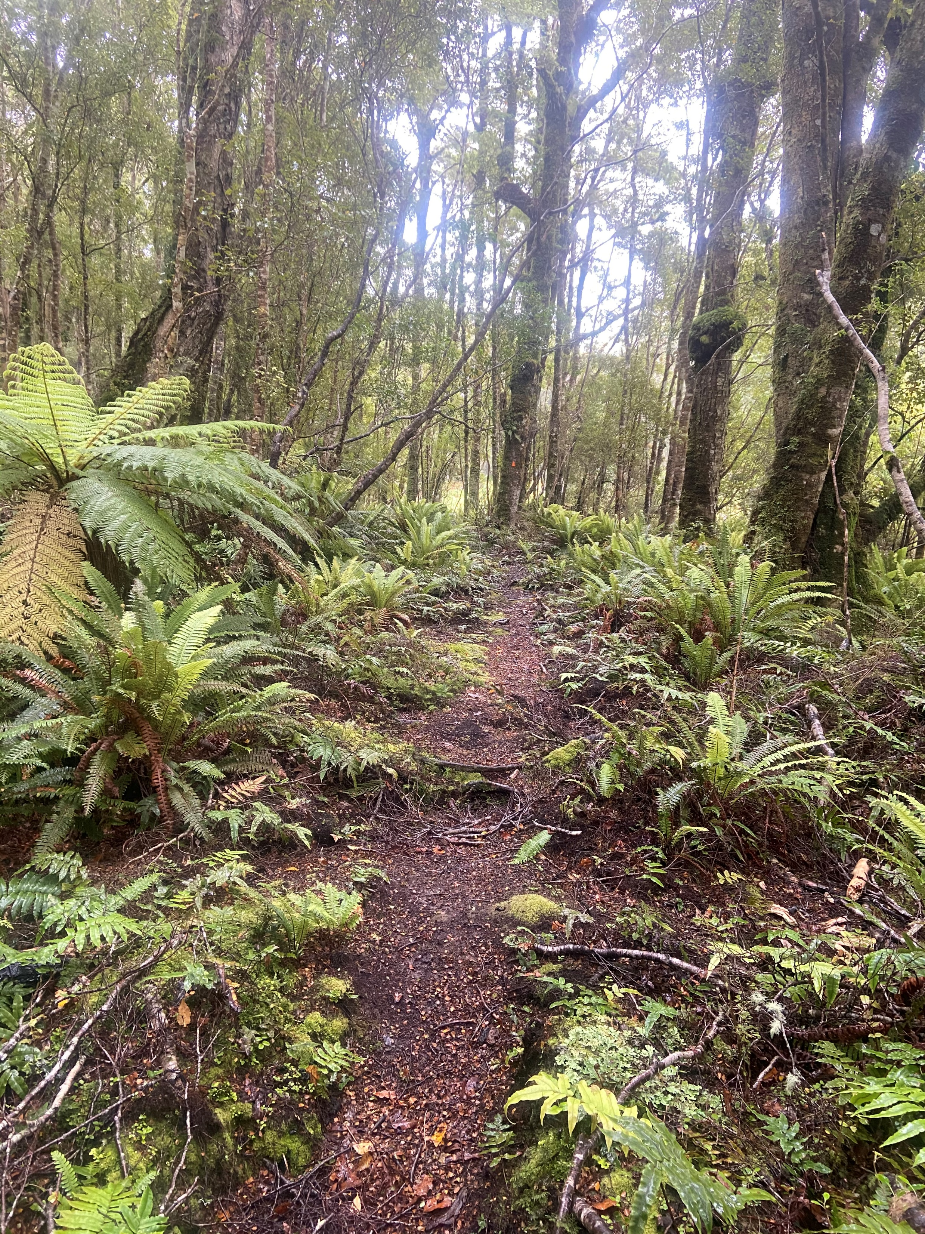
Draft Climate Change Policy
The consultation period runs until Friday 4 August 2023.
Submissions and feedback to consultation@lawsociety.org.nz

Slide 8

4. Panel discussion

Slide 9
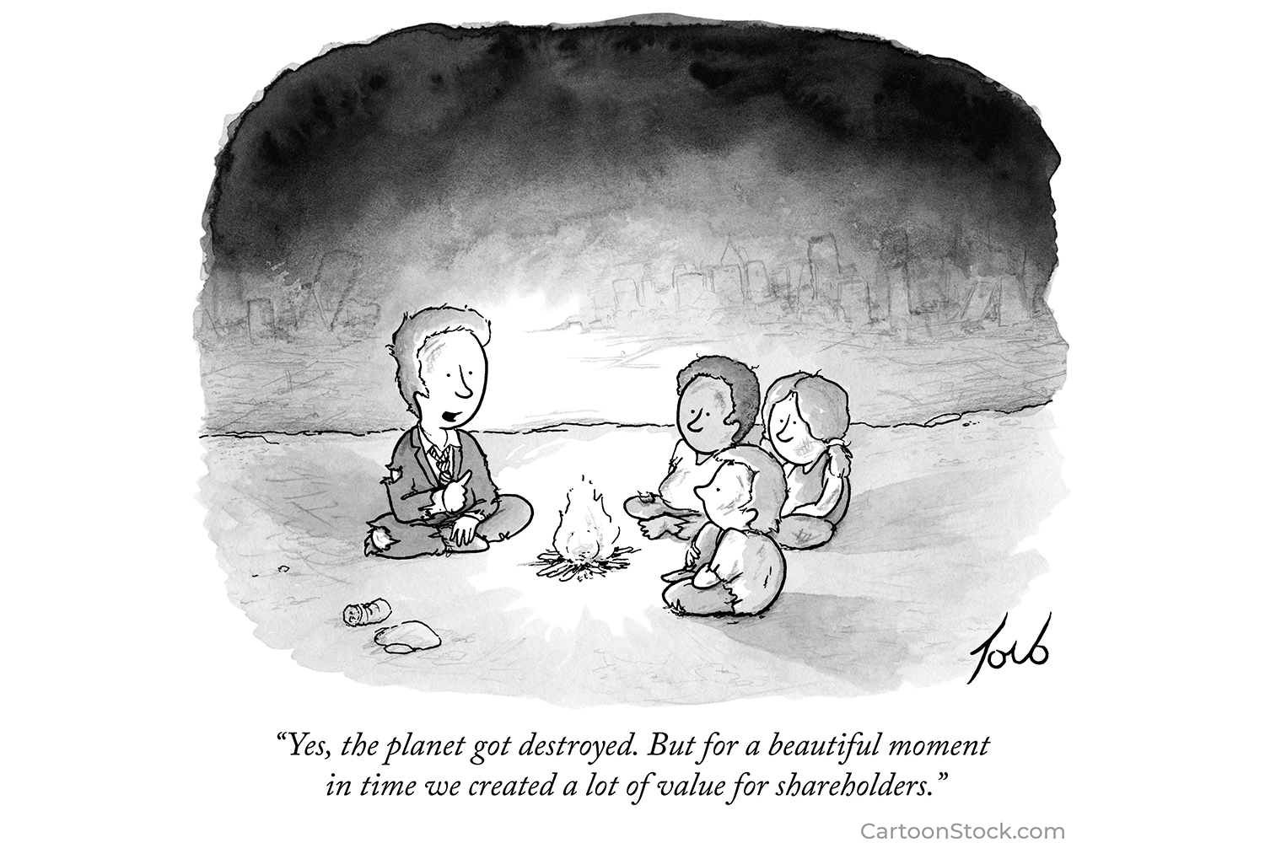
gave a lot of good advice to our clients.”

