Slide 1
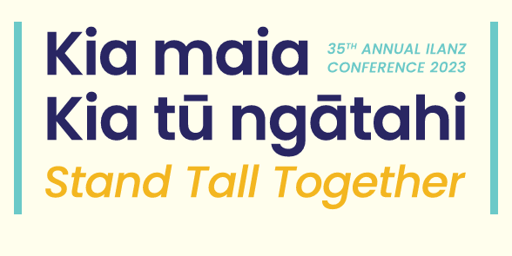
Effective engagement with tangata whenua
How to achieve mutually beneficial outcomes
Mary Hill, Partner
Tanya Waikato, Special Counsel

Slide 2
Overview
Goal
Perspective
Constructs
Studies
Suggestions
Mary Hill, Partner

Slide 3
Goal
Effective engagement with tangata whenua
How to achieve mutually beneficial outcomes
Mary Hill, Partner

Slide 4
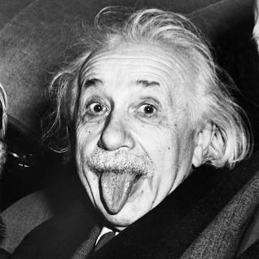
Relevance of perspective
You cannot solve a problem with the same mind that created it
Mary Hill, Partner
Notes:
Theme we will develop:
May require more than just an open mind
May need to view problem with a different mind – often references to Te Ao Māori - Māori world view
Challenge:
Seeing the world differently whilst fulfilling function as lawyers and duty to court and clients
Perspective I bring is naturally a pakeha one
And a practitioner one
Enlist the help of wise people – that’s why I have TCW to co-present

Slide 5

Some psychology
We’re wired to fill in knowledge gaps with biases
There are primal reasons for this
In the face of a threat to life our brains evolved to ‘think quickly’ not ‘think correctly’
As lawyers we are well suited to learning both sides of the argument
Studies show this is one way to gain perspective
Mary Hill, Partner
Notes:
2022 research based study by UCLA Psychology Professor Matthew Leiberman PhD published in published in the journal Psychological Review,

Slide 6

Constructs
WAIL principles
Must listen and consider
Need not agree
Genuine not a sham
Allow sufficient time
Provide information to enable informed response
It’s ok to have a plan in mind but keep an open mind – be ready to change - even start afresh
Mary Hill, Partner
Notes:
Good place to start. Widely accepted consultation principles for public agencies
Wellington International Airport Ltd v Air New Zealand (1992 CA)
Often followed including more recently in Trustpower v Electricity Authority 2016 HC (Cull J) where Court also considered consultation psychology – evidence re:
“consultation fatigue” - risk of fatigue resulting in desire to force an outcome
“confirmation bias” - tendency to confirm initial hypothesis despite contrary evidence

Slide 7

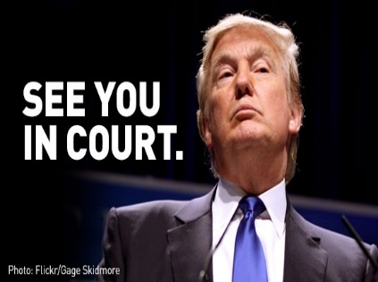
Different paradigms?
“Meeting of the minds” v Strategic approach”
Mary Hill, Partner
Notes:
Two different approaches or paradigms
Ngati Rangi Trust v Genesis Power Ltd (2009 – CA)
“Meeting of minds” phrase coined by EC
Effectively a “construct” to fit a Māori paradigm into a non-Māori framework (i.e. resource consent process)
Iwi failed to specify measures to mitigate effects of river diversion on power scheme
Regional Council granted powerco 35 year consent
EC found diversion necessary but also substantial prejudice to cultural values
EC reduced term to 10 years to allow “meeting of minds” on long term mitigation
i.e. let’s take a pause and allow parties to work though issues and reach an accommodation
What I’ve coined the “see you in court” approach (or more kindly the “strategic” approach) of HC and COA
“meeting of the minds” can’t be used to fill evidential gap (iwi failing to specify mitigation)
Assumes the following litigation strategy:
Tangata whenua entitled to take principled stance/not engage in negotiations re mitigation
They run the risk of consent granted without conditions to mitigate effects
Applicant entitled to not engage and say “see you in court”
Not a breach of natural justice to fail to engage further in those circs
Although a 2009 case, COA (Chambers’ J) position recently affirmed in Gock v Auckland Council – 2022 HC (Duffy J). Re location of RUB on Pukaki peninsula in Auckland

Slide 8
Meeting of the minds?
Māori relationships not always about people
Need to be understood not negotiated
Deep connections with land, water, atua
Connections often intangible
Founded on “beliefs” not evidence
Sharing of matauranga requires trust and time
Mary Hill, Partner

Slide 9
Strategic approach
Māori may wish to exercise “principled opposition”
Applicants (even public agencies) can call time on discussions
Courts can’t plug evidentiary gaps by requiring engagement
Courts can’t require a shorter term to allow for meeting of minds
Mary Hill, Partner

Slide 10
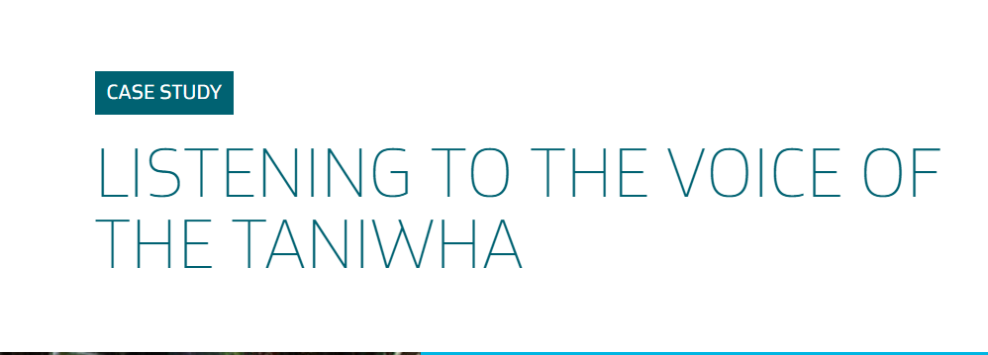
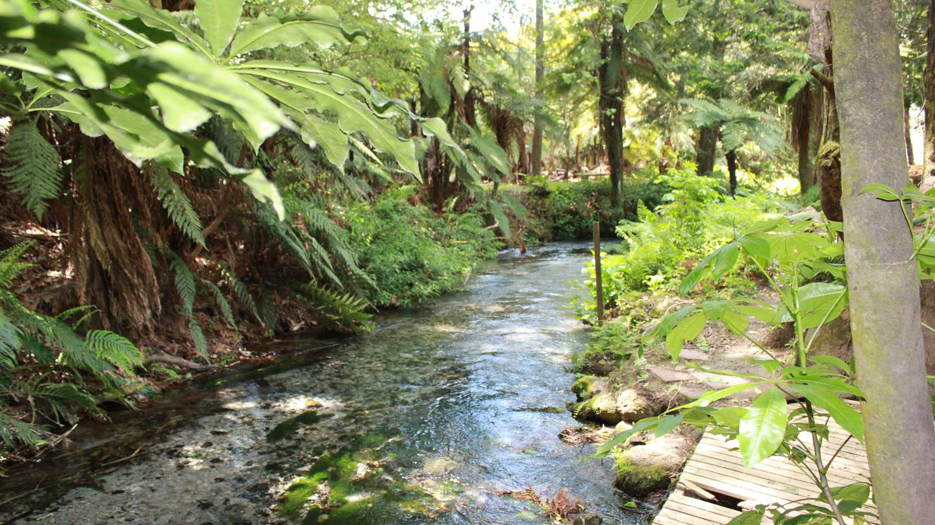
A better way?
A partnership between Ngāti Rangiwewehi and Rotorua Lakes Council resulted in a joint consent for ongoing water take from the spring, believed to be the first such consent of its kind.
Mary Hill, Partner
Notes:
2009 Environment Court – Judge Whiting
Around same time as “meeting of the minds” case
Te Maru o Ngati Rangiwewehi v Bay of Plenty Regional Council
25 year consent granted for municipal water take from “taniwha springs” (Puna o Pekehāua)
Maori appellants sought “run out” 10 year consent to enable springs to be returned (taken under PWA in 60s).
Responsibilities of the District Council to operate a potable water supply vs acknowledged significant cultural values
Ground water was another option but Court found not fully investigated by RDC
Court granted short term consent to enable ground water to be investigated
In the event:
Ngāti Rangiwewehi’s and Council entered into a partnership which saw:
Springs retuned to iwi ownership in 2015
A joint resource consent for ongoing community water supply (first of its kind).
Decommissioning and removal of existing pump station over the spring to restore mana and mauri to the site - the place where the taniwha Pekehaua resided
GNS science worked with iwi to develop a “kaitiaki flow” - how much water could be taken without compromising mauri stream.
Flow built into the supply consent (water use only allowed when stream flow greater than kaitiaki flow - 90 per cent of the natural flow).
new flow measurement site installed to provide iwi with monitoring data.

Slide 11
“There comes a time when those who are adversely affecting Māori by their activities need to "bite the bullet" if there are viable alternatives, especially when the activities were instigated without acknowledging Māori culture.”
Environment Judge Gordon Whiting
"While our past grievances run deep, we have a partnership with the council that is built on mutual trust and respect and what is best for the community as a whole has always been a key factor in our decision-making.“
Louis Bidois, Ngāti Rangiwewehi
Mary Hill, Partner
Notes:
Key point: mutually beneficial outcome not a win for one side
Involved compromise
Takes time and can’t be done under pressure of litigation
Needs to occur at front end (design phase)

Slide 12

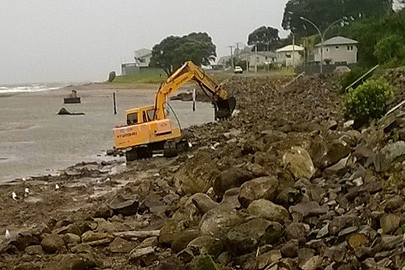
Mary Hill, Partner
Notes:
Much more simple example of making same point
2014 District Council undertaking maintenance on sea wall
Taking tapu stones from beach with digger to maintain wall
Ongoing issues / complaints
2019 got consent to construct a new wall based on new design
Rather than consulting at design stage left it to consent process to allow iwi to lodge objection
Prior to hearing we advised them to walk on site with iwi to understand concerns
Resulted in project being placed on hold
Council agreed to review design
Key features of new design:
A curved/concave shape to blend into coastline
Natural shape reflecting natural processes
more attractive appearance
Also offered an opportunity to centralise access from the carpark onto the beach
Better view to sea from café

Slide 13

Key barriers to effective engagement
1. Not engaging early enough
2. Engaging with the wrong people
3. Not getting help
Mary Hill, Partner
Notes:
Acknowledge above examples were public projects
Two recent examples of private projects (but having public benefit) which have suffered from these issues. Still waiting decisions from courts so will discuss generically
Some lessons learned

Slide 14
Tricks of the trade
Seeking “mana to mana” conversations (i.e. at board level)
Involvement in design of project not just monitoring effects
Incorporation of mātauranga with western science not instead of
Engage early
Engage on the marae – visit the site – share kai – build relationships
Engage with the right people – this may change
It’s ok to engage a tikanga expert – changing trend
Not intended to replace tangata whenua who hold mana at place
Mary Hill, Partner
Notes:
Can design intermediate entity e.g. if publicly listed company and can’t provide board seats /concerned about conflict (recommendatory only)
Design changes can be simple but effective – don’t assume token
Built relationships before project exists – then well placed when new matter arises
Establish “kaitiaki forum” outside of consenting construct to seek cultural advice
Or may warrant in-house cultural advisor (not always effective due to conflicts)
Noting shift towards getting independent tikanga expect – can assist with engagement process – not intended to speak for tangata whenua – these types of experts can also assist the Court
Can also assist with process of who to engage with – this can be established at marae level (e.g. where concern that particular individual may not have mandate)
Use tools eg. iwi and hapū management plans
New NBEA providing some guidance from Te Puni kokiri – recognised as an issue eg. TECT case

Slide 15
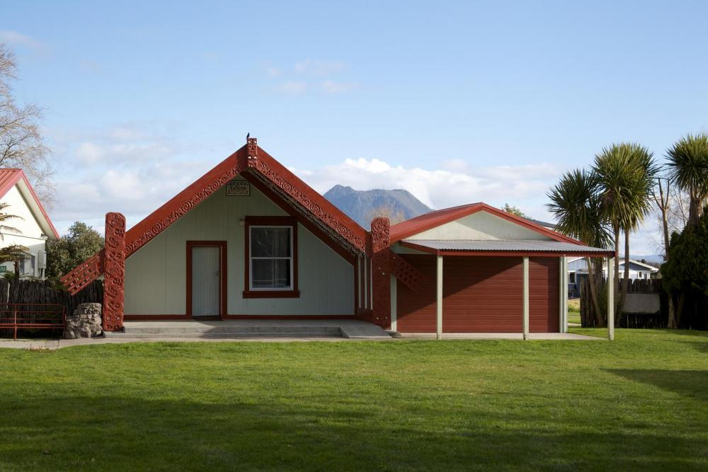
Effective engagement: A tangata whenua perspective

Slide 16
Part 2: Engagement Tikanga
Four principles of tikanga to guide effective engagement:
Mana: The source of rights and obligations of leadership.
Whakapapa: The source of the rights and obligations of kinship.
Tapu / Noa: The paired concepts of the sacred and ordinary.
Utu: The obligation to give and the right to receive reciprocity.
Tanya Waikato, Special Counsel

Slide 17

Part 2: Engagement Tikanga
Mana: Authority, power, the right to speak for an area / people. Must be recognised through respect of engaging with holders of mana whenua, kanohi ki te kanohi, may require multiple levels of engagement over time.
Tanya Waikato, Special Counsel

Slide 18
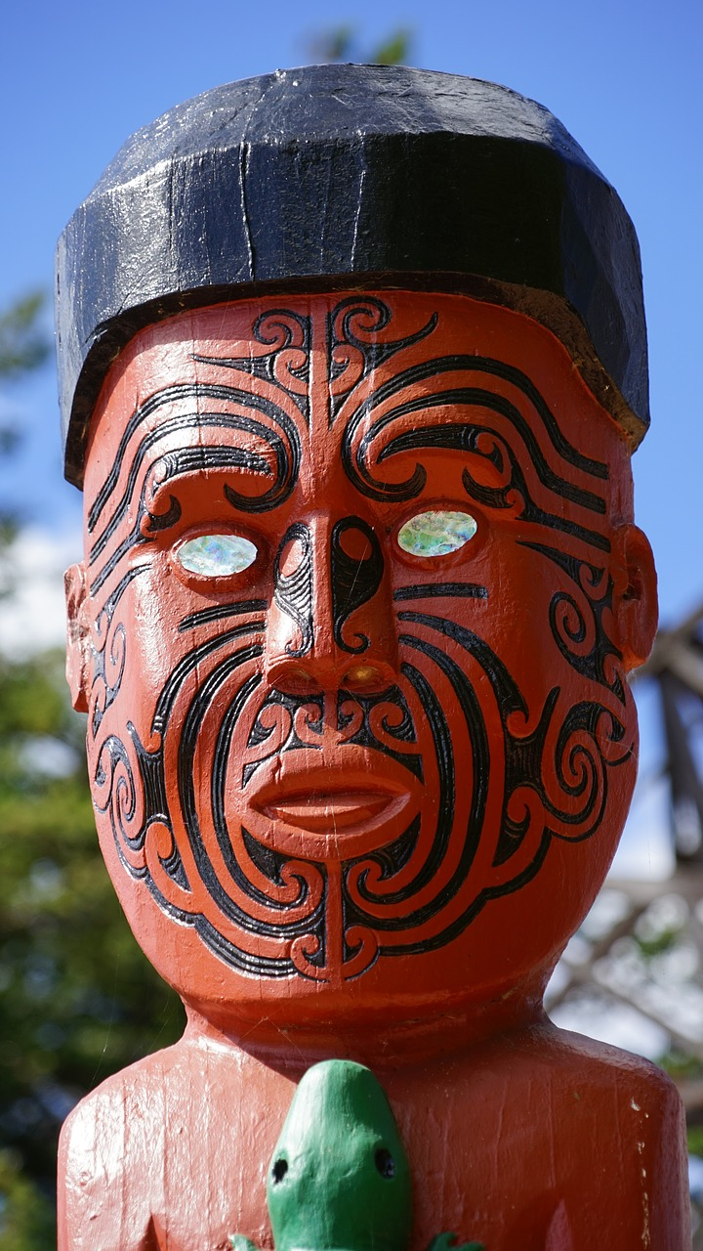
Part 2: Engagement Tikanga
2. Whakapapa: Genealogy determines mana whenua, plays important role in identifying correct parties to engagement, can be subject to internal disputes. Must be recognised through direct engagement, can be required at multiple levels.

Slide 19
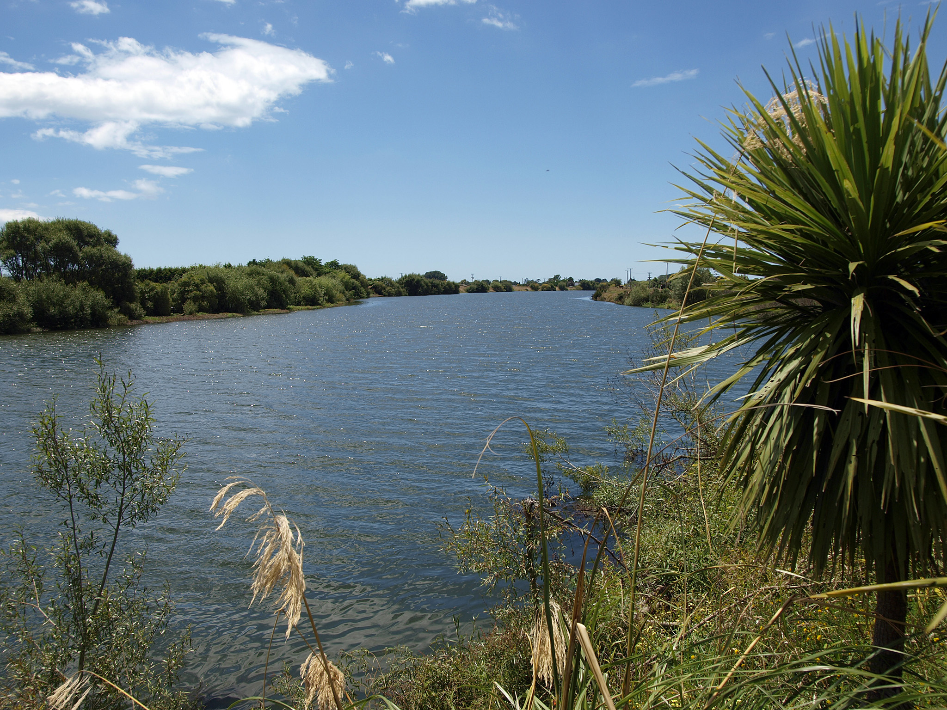
Part 2: Engagement Tikanga
3. Tapu / Noa: Engagement approach needs to recognise any aspects of tapu that are relevant e.g. presence of wāhi tapu.

Slide 20

Part 2: Engagement Tikanga
4. Utu: Reciprocity should be included in engagement mindset and can include benefit sharing models and co-governance opportunities.
Tanya Waikato, Special Counsel

Slide 21
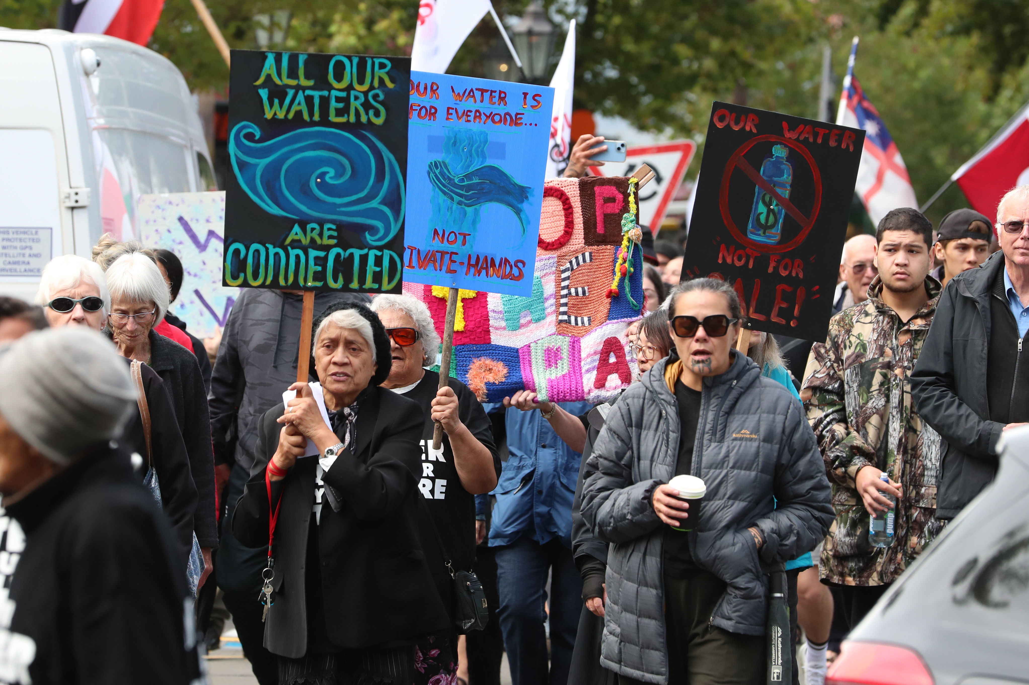
Case study – What not to do
Tanya Waikato, Special Counsel

Slide 22
Case study – What not to do
Large corporate, renewing resource consents with major changes to conditions affecting river.
Consultation with iwi authority only - in a different town.
Failure to engage direct with seven hapū living on the river.
Intense opposition to application, failure to recognise mana, whakapapa, utu, tapu / noa = large protests at hearing.
Costly loss at initial level for corporate before resolution reached through mediation.
Relationship now repaired, engagement strong through long term partnership model.

Slide 23
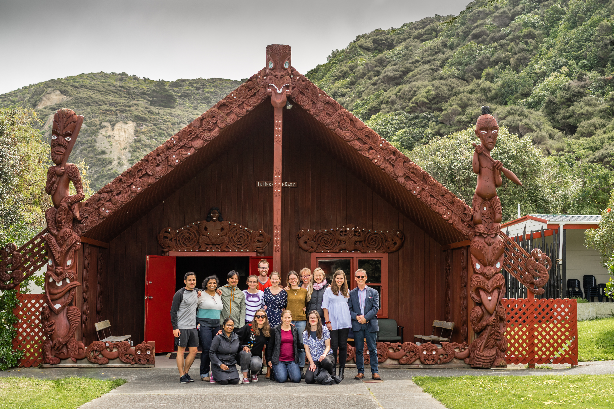
Case study – How to do it right
Tanya Waikato, Special Counsel

Slide 24
Case study – How to do it right
Second large corporate, renewal of consents, same river.
Very early engagement at hapū level, two years prior to application submission.
Multiple engagements kanohi ki te kanohi, full complement of experts and company representatives.
Site visits and recognition of utu via benefit sharing, internships, job opportunities.
Further engagement at iwi level.
Recognised mana, whakapapa, utu, tapu/noa.

Slide 25

Patai??

